Slide 1
How to use this slide deck:
Determine the specific education goal and length of your presentation.
Choose slides that pertain to that goal.
Hide all other slides.
Consider and include additional messaging as it relates to your initiative, as appropriate.
Questions or comments? Neal.Fobian@iowadot.us

Slide 2
Des Moines Metro Area Integrated Corridor Management
Month Date, Year

Slide 3
Agenda
Project Overview
Benefits
Current Efforts
Summary
Notes:
Adjust agenda to slide content selected for the presentation.

Slide 4
Des Moines ICM Project Overview

Slide 5
What is Integrated Corridor Management (ICM)
Focuses on solutions for different modes of transportation
Goal to help all modes of transportation work more seamlessly together throughout the region.
Saves money compared to projects that simply expand the road and bridge system.
Notes:
Integrated Corridor Management focuses on solutions for different modes of transportation. The goal is to help all modes of transportation work more seamlessly together throughout the region. This solution also saves money compared to projects that simply expand the road and bridge system.

Slide 6
What is the ICM Project?
The integrated corridor management (ICM) concept provides a framework for coordination among all areas of transportation- making sure we utilize and improve multiple modes and not just freeways.
It is a collaboration of multiple agencies working together to improve transportation in our community as a network and not as separate segments.
Notes:
Instead of just expanding freeways, it uses all available options to maximize benefits. The integrated corridor management (ICM) concept provides a framework for coordination among all areas of transportation- making sure we utilize and improve multiple modes and not just freeways. It is a collaboration of multiple agencies working together to improve transportation in our community as a network and not as separate segments.

Slide 7
Notes:
Coordination and collaboration between agencies is an essential part of ICM strategies. For Des Moines, this partnership includes DART, Des Moines Area MPO, the US Department of Transportation Federal Highway Administration, Iowa DOT and local jurisdictions.

Slide 8
What is the ICM Project?
The Iowa DOT is studying strategies to manage traffic and improvements to the transportation system to most cost-effectively and proactively improve traffic flow and safety in the Des Moines metropolitan area.
We are looking at technology and other ways to manage the transportation system to best meet current and future transportation needs.
Notes:
The Iowa DOT is studying strategies to manage traffic and improvements to the transportation system to most cost-effectively and proactively improve traffic flow and safety in the Des Moines metropolitan area. We are looking at technology and other ways to manage the transportation system to best meet current and future transportation needs.

Slide 9
What is the ICM Project?
Many agencies are working together to balance traffic across a variety of roads and transportation modes.
The overall goal is to make trips seamless and convenient for commuters across the metro area.
Notes:
Many agencies are working together to balance traffic across a variety of roads and transportation modes. The overall goal is to make trips seamless and convenient for commuters across the metro area.

Slide 10
What is the ICM Project?
The first phase of this project focused on a long-range plan for improvements that we aren’t used to seeing in this area - ramp metering, dynamic shoulder use, and encouraging commuters to change their behavior, such as increasing the use of public transportation, cycling, ride share, and telecommuting.
An online meeting was conducted in late 2020 to receive feedback from the public. We are working on a plan to educate the public on these strategies and communicate progress with stakeholders.
Notes:
What is the ICM project in Des Moines? The first phase of this project focused on a long-range plan for improvements that we aren’t used to seeing in this area - ramp metering, dynamic shoulder use, and encouraging commuters to change their behavior, such as increasing the use of public transportation, cycling, ride share, and telecommuting. An online meeting was conducted in late 2020 to receive feedback from the public. We are working on a plan to educate the public on these strategies and communicate progress with stakeholders.

Slide 11
Notes:
ICM strategies have been implemented in several states, including Missouri, Kansas, Minnesota and Colorado.

Slide 12
Why ICM for Des Moines Metropolitan Area?
Notes:
But why ICM for Des Moines? The Des Moines metro area experiences more congestion due to bad weather and traffic incidents compared to the National Averages. This calls for non-traditional solutions instead of only expanding the freeway systems.

Slide 13
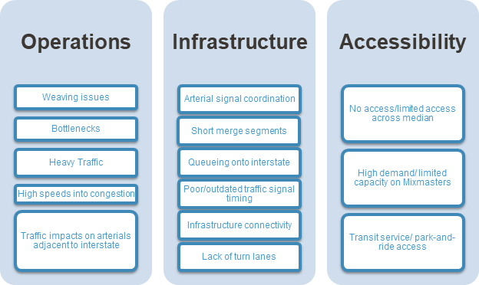
Why ICM cont. - Identified Issues
Roadway signal coordination
Back-ups onto interstate
More traffic than interstate has capacity for
Sudden stopping on interstate
Incidents on nearby roadways
Figure 1. Existing Transportation Conditions/Problems in Des Moines Metro Area [Source: ICM Visioning Workshop]
Notes:
Here are the issues identified for the Des Moines metro area during the ICM Visioning Workshop. Read as many items in each category as relevant to the group; recommend at least one per category.

Slide 14
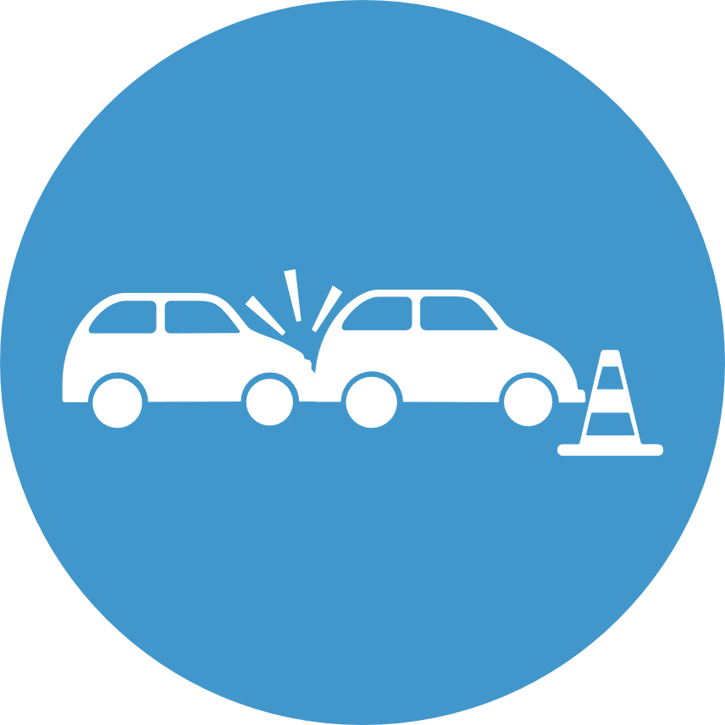
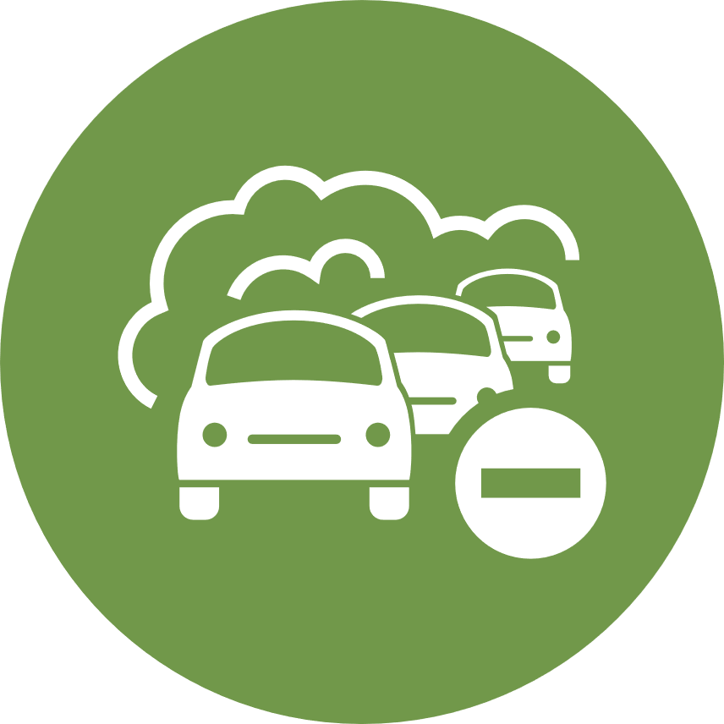
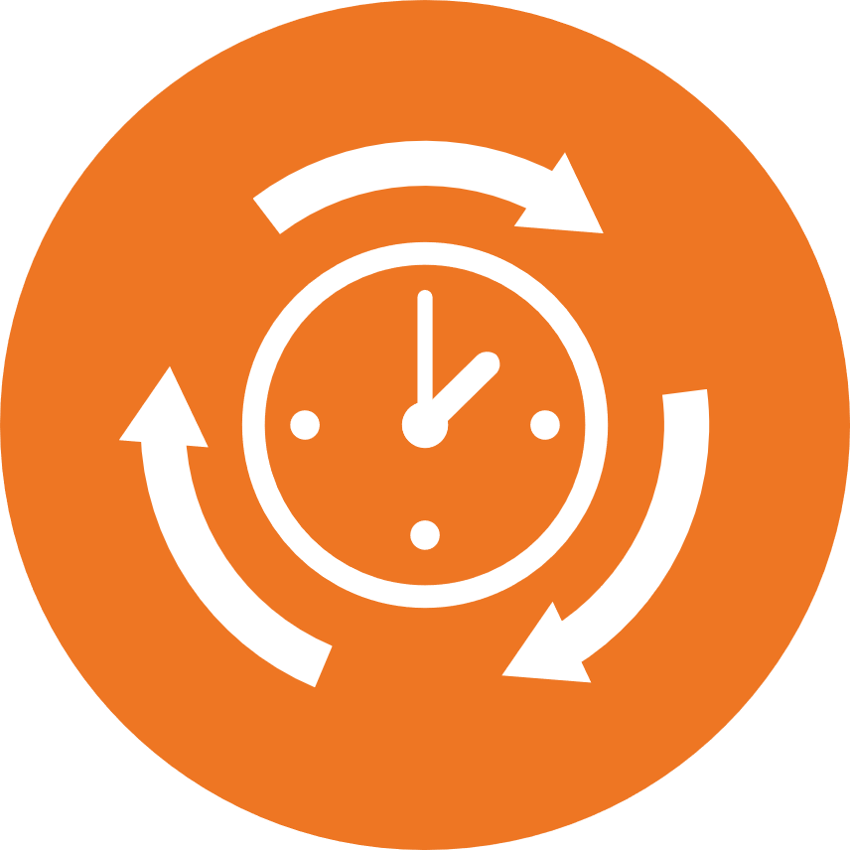
What are ICM’s benefits?
Notes:
There are several benefits to ICM strategies:
Fewer traffic incidents, particularly ones that occur as a result of another incident
Safety and mobility improvements due to faster incident response and management
Increased use of other routes or travel options to meet the demand of traffic
Reduced vehicle emissions and fuel consumption resulting from congestion.
Increased or more complete information about other routes or travel options if an incident or traffic congestion does occur.
More predictable travel times.
Ability to more quickly make incident information available on traveler information sources.

Slide 15
What We Heard from You
By working together, we can identify safe, reliable, and cost-effective solutions for the Des Moines metropolitan area.
Results of the online meeting indicate that residents are mostly interested in transportation improvements that don’t involve increasing freeway traffic lanes, but enhancements to public transportation, commuter alternatives, and freeway safety improvements such as ramp metering.
Notes:
By working together, we can identify safe, reliable, and cost-effective solutions for the Des Moines metropolitan area.
Results of the online meeting indicate that residents are mostly interested in transportation improvements that don’t involve increasing freeway traffic lanes, but enhancements to public transportation, commuter alternatives, and freeway safety improvements such as ramp metering.

Slide 16
What We Heard from You
Des Moines Commuters Travel By:
Source: Des Moines ICM Commuter Survey, Q4 2020
Notes:
Des Moines commuters travel predominately by single passenger vehicle. Bike commuting is the second most popular option, followed by public transportation and carpooling.

Slide 17
What We Heard from You
What kind of improvements do you want to see?
Notes:
The Des Moines ICM Commuter Survey also asked participants what kind of improvements that want to have made in Des Moines. 33% want methods to improve safety across all systems. 25% want to see improvements that improve congestion on roadways. Other suggested strategies by participants were expanding freeway lanes, improving pedestrian and bicyclist commutes, parking solutions and more accessibility of public transit options.

Slide 18
Current ICM Strategies Implemented

Slide 19
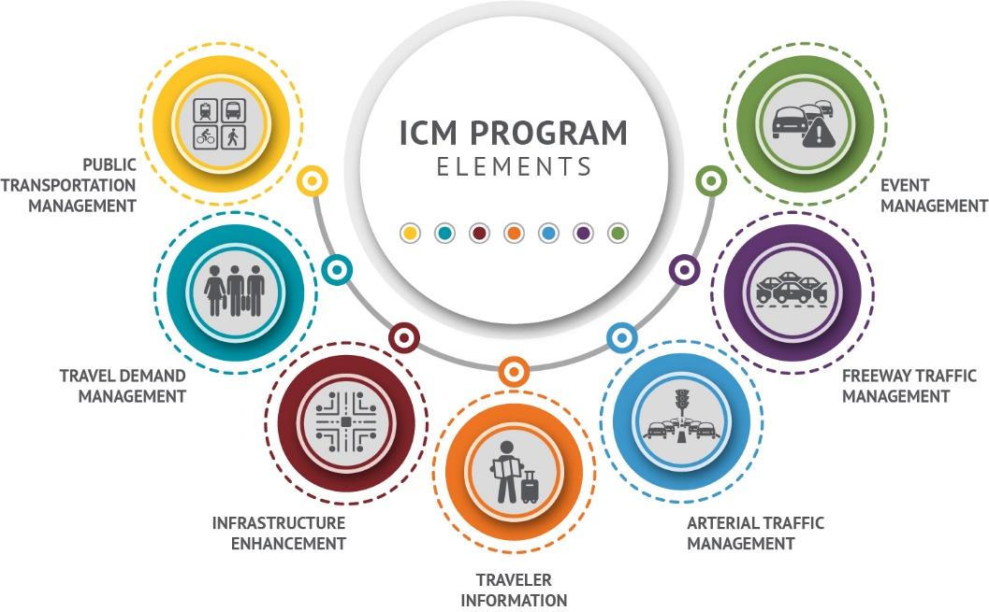
ICM Program Elements
Notes:
The elements of the Des Moines ICM strategy are:
Public Transportation Management: Improvements to public transit and public education of available options.
Travel Demand Management: Spread out commuting so there aren’t as large of peak demands.
Infrastructure Enhancement: Installation of tools and systems on the freeway to improve traffic flow and safety, such as ramp meter.
Traveler Information: Make it easy for commuters to be informed of traffic incidents and make adjustments to their commute.
Arterial Traffic Management: Improve other roadways to enhance traffic flow onto the freeways.
Freeway Traffic Management: Adjusting traffic flow on the freeway system.
Event Management: Accommodating increased traffic due to an event, such as a game or concert.

Slide 20
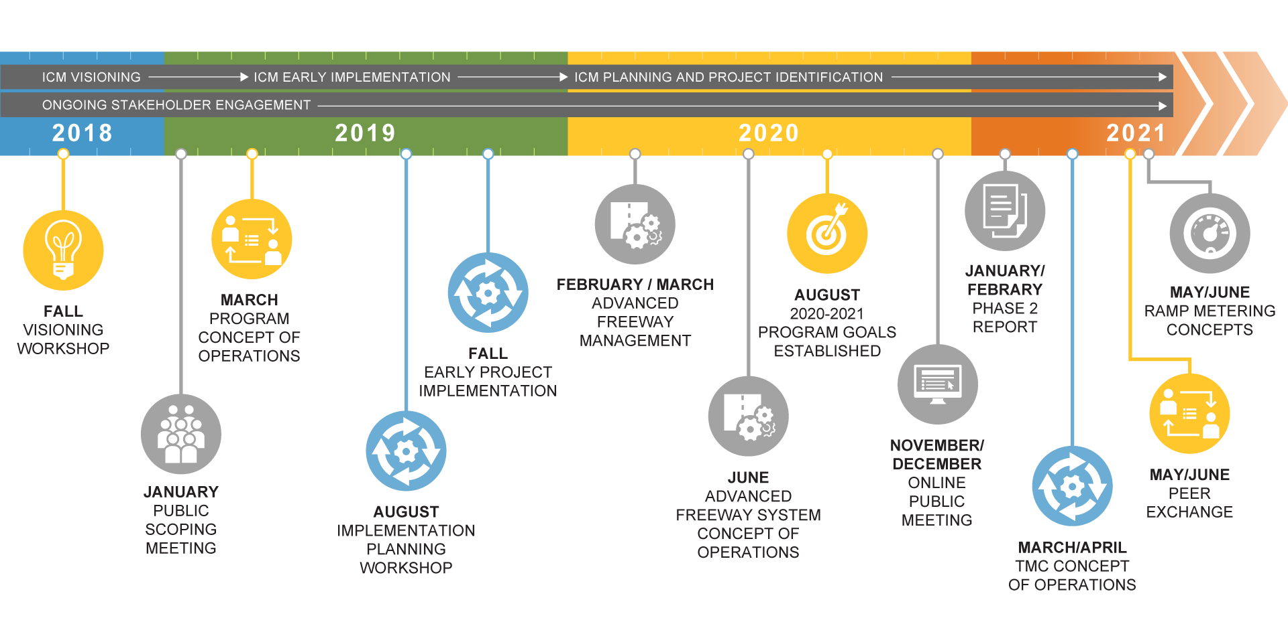
ICM Program Schedule
Notes:
ICM strategy and planning is underway. A peer exchange workshop took place in May 2021 and the first strategy to be implemented will be ramp meters.

Slide 21
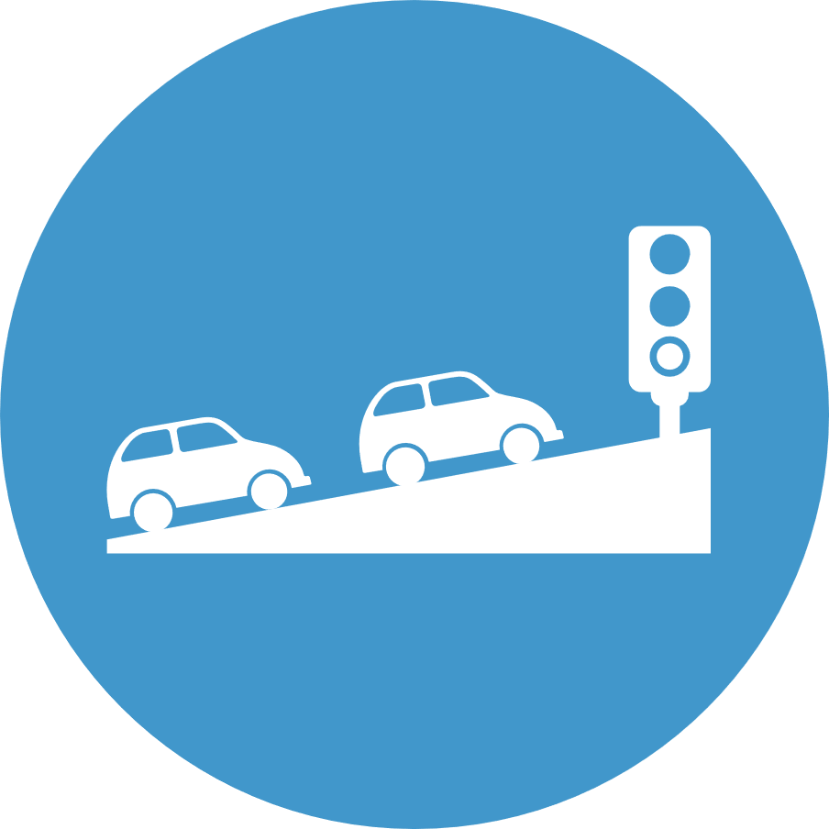
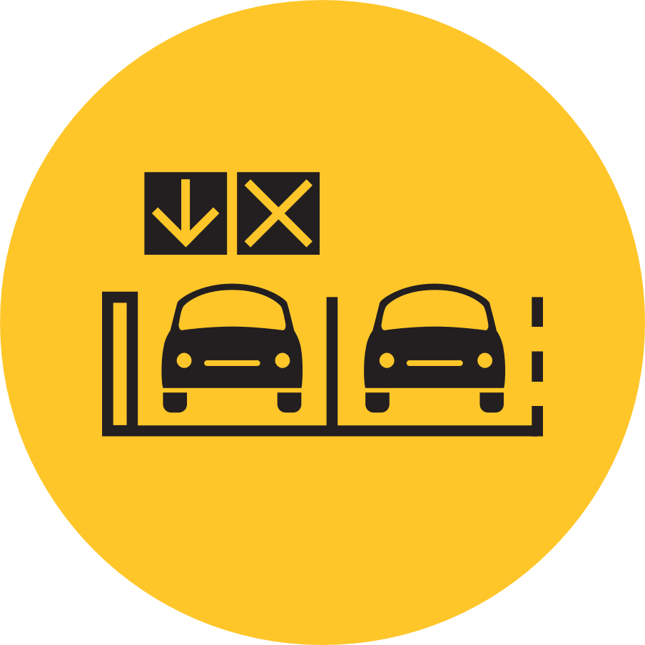
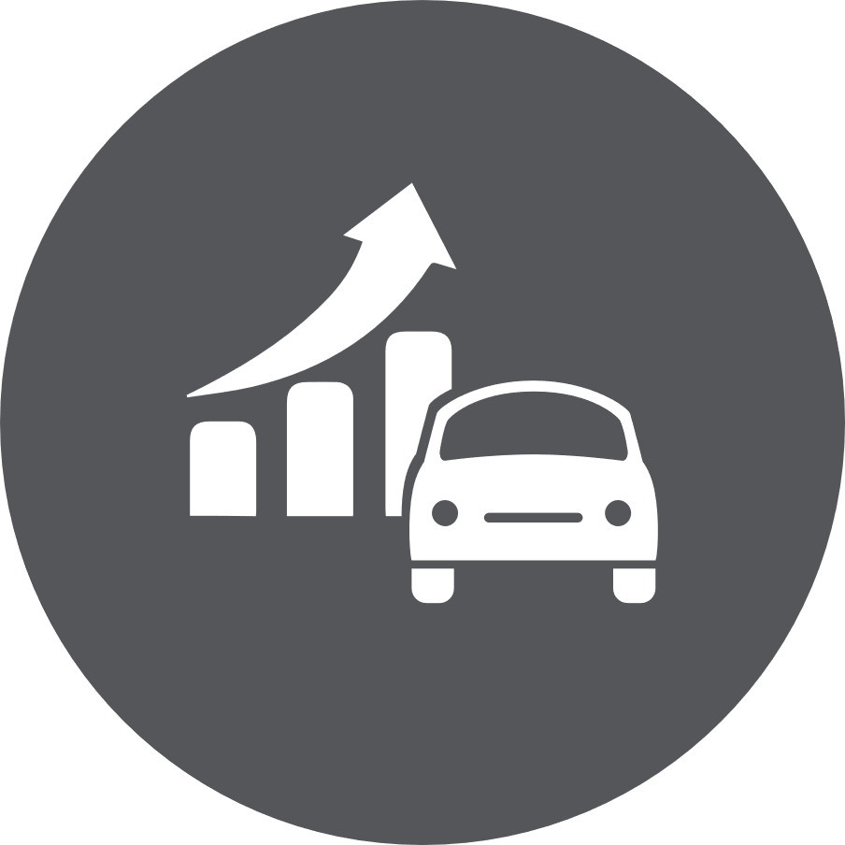
What Initiatives are Coming Next?
New initiatives coming to the metro including:
Ramp Metering
Dynamic Shoulder Use
Travel Demand
Management
Notes:
By learning early on about these changes coming to your transportation, you’ll be better prepared to acclimate to new road rules and infrastructure.
You can also be empowered to enhance your commute after discovering all of the transportation options available to you.

Slide 22
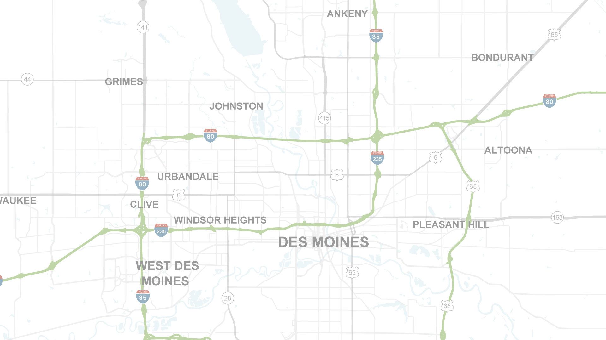
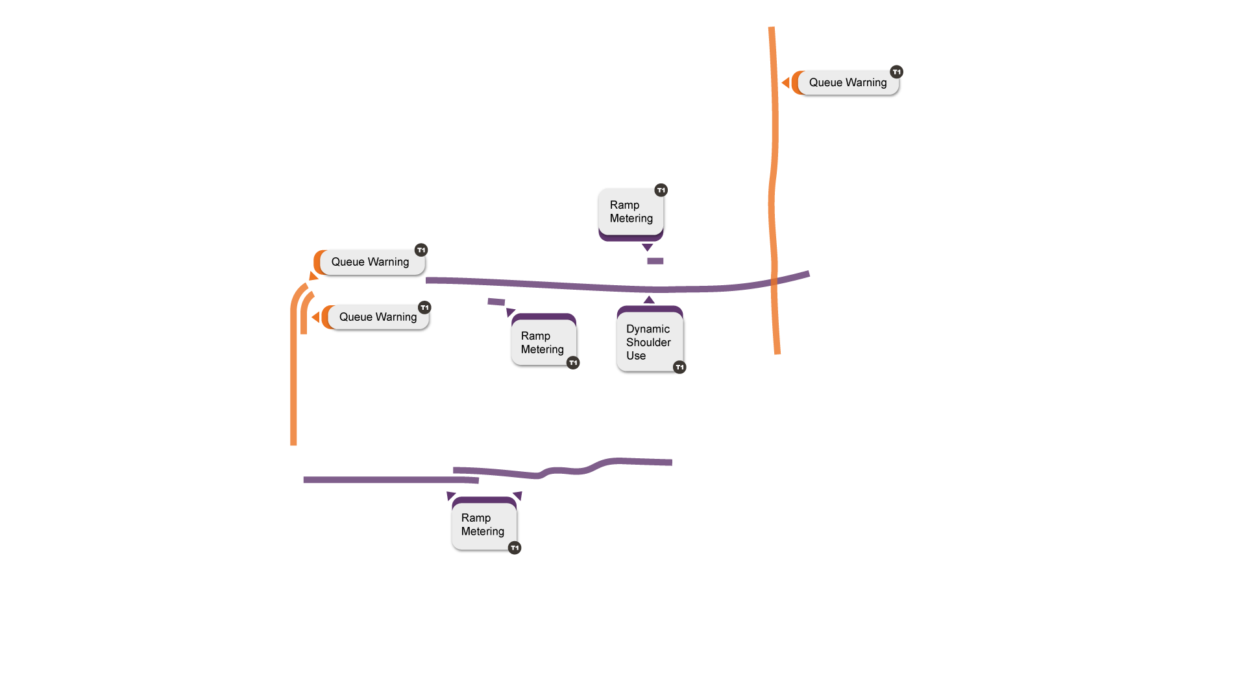
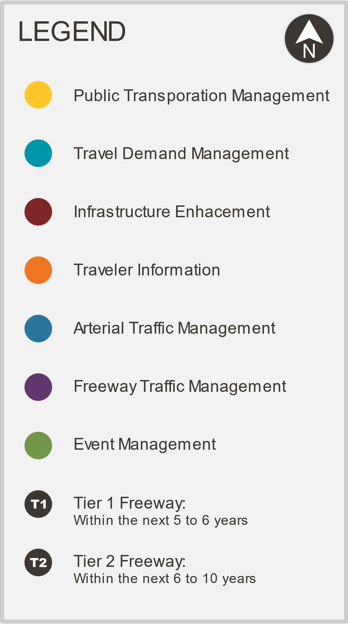
Corridor Improvements
Proposed ICM projects have overlapping boundaries and are offset for readability.
Notes:
Iowa DOT is currently in the process of programming study recommendations. This map shares the recommended improvements for the first 5 years of improvements.
Ramp Metering along Interstate 235 – Eastbound between the Southwest MixMaster and 63rd Street – also Westbound from 2nd Avenue to 63rd Street
Dynamic Shoulder Use in both directions on Interstate 35/80 between 86th Street and the Northeast MixMaster
Queue Warning (overhead message signs and new detection capabilities) on Interstate 35/80 between the Southwest MixMaster and IA 141 – also on Interstate 235 northbound continuing north on Interstate 35 up to E 1st Street

Slide 23
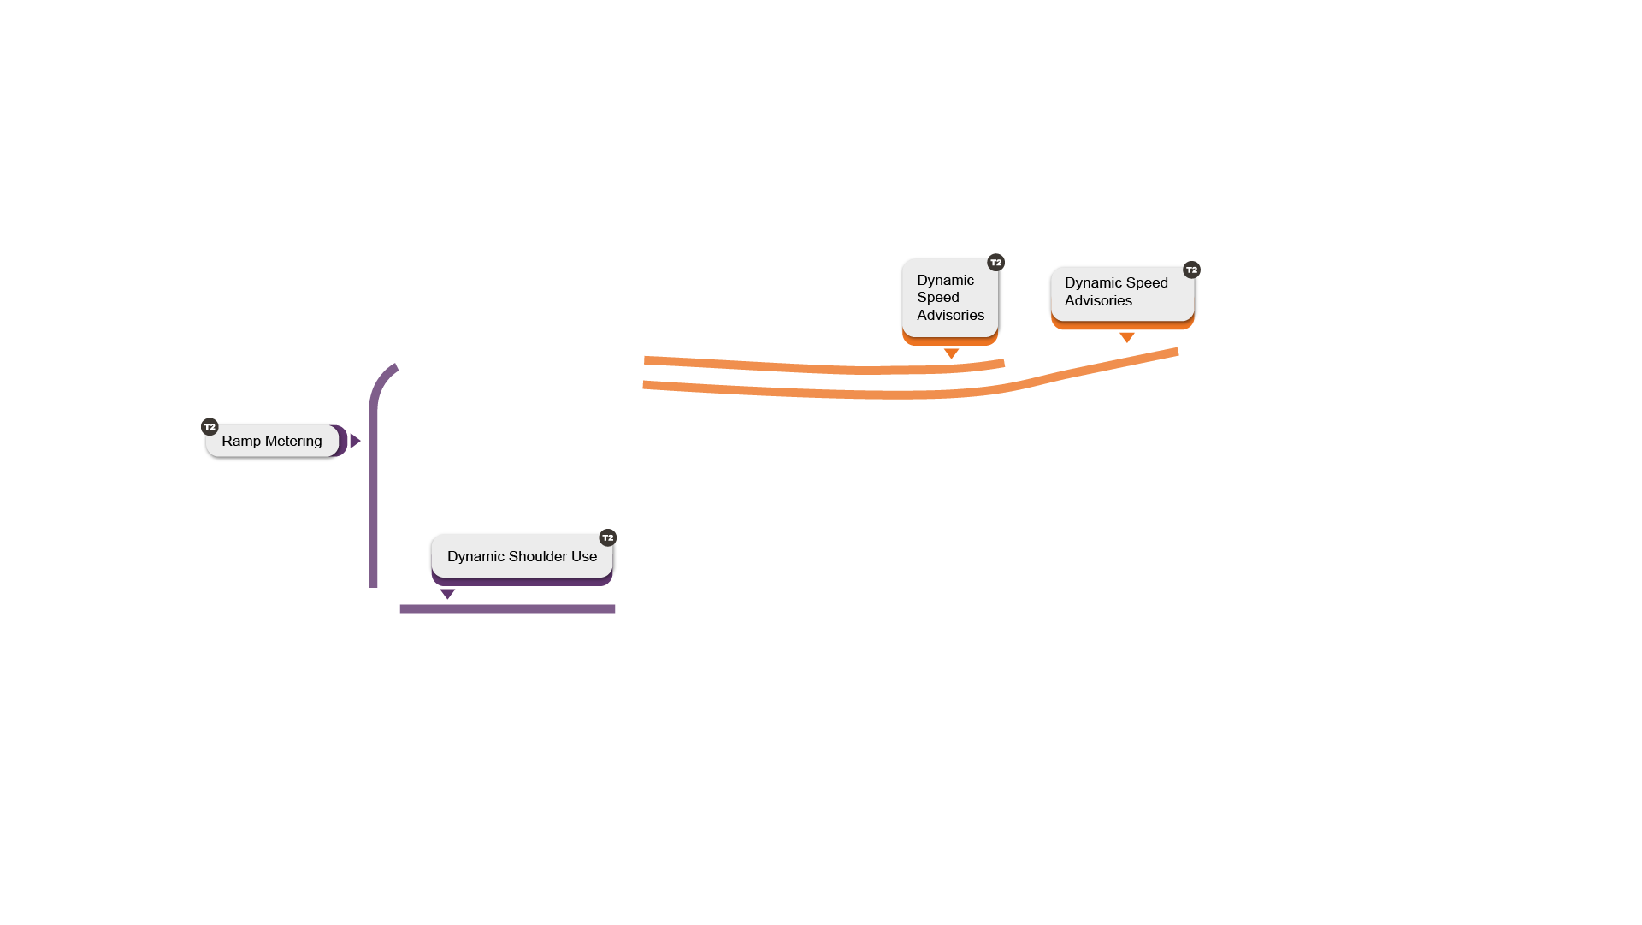
Corridor Improvements
Proposed ICM projects have overlapping boundaries and are offset for readability.
Notes:
In the next 5 years, new deployments of advanced freeway strategies will be prioritized
Dynamic Shoulder Use on Interstate 235 between the Southwest MixMaster and 63rd Street
Ramp Metering southbound on Interstate 35 / 80 from IA 141 to the Southwest MixMaster
Dynamic Speed Advisories between Merle Hay Road and US 65 on Interstate 35 / 80

Slide 24
Ramp Metering
Notes:
A way to reduce traffic congestion and increase freeway safety is to install ramp meters.

Slide 25
What is Ramp Metering?
Ramp meters are traffic signals installed on freeway on-ramps to control the frequency at which vehicles enter the flow of traffic on the freeway.
With fewer vehicles trying to merge simultaneously, safety improves – crashes are reduced by up to 40%.
Traffic back-ups often start when too much traffic hits at once – with ramp meters the mainline freeway operations have fewer hard stops, improving travel times
Notes:
Ramp meters are easy-to-use traffic signals added to freeway on-ramps to help you safely merge during peak hours. They are installed on freeway on-ramps to control the frequency at which vehicles enter the flow of traffic on the freeway. By limiting the number of vehicles that can enter the freeway at the same time, safety improves – crashes are reduced by up to 40%. Traffic back-ups often start when too much traffic hits at once. Ramp meters the mainline freeway operations have fewer hard stops, also improving travel times.

Slide 26
Why Was Ramp Metering Selected?
Traffic growth in the metro has led to stop and go conditions on I-235 in the peak period
Traditional widening would not be projected to reduce crashes or support a better managed system for traveler reliability
Ramp metering has proven to address project goals and be cost effective to support expedited project delivery
Notes:
Why were ramp meters selected for the Des Moines ICM project? Traffic growth in the Des Moines metro area has led to stop and go conditions on I-235 in peak travel periods. Traditional freeway widening would not be as effective at reducing crashes or improving travel reliability and traffic flow. Ramp metering has proven to address project goals and be cost effective to support expedited project delivery.

Slide 27
Notes:
Research in Miami, Florida found freeway crashes decreased by 41 % when ramp meters were operational. By only allowing one vehicle to enter the freeway at a time, ramp meters harmonize traffic flow and level out differential speeds, which reduces hard-braking and sudden lane-changing events. This reduces the chances of rear-end and sideswipe crashes, which account for over 90 % of crashes on I-235 during the evening peak hours.

Slide 28
How Do Ramp Meters Work?
Merging with an active ramp meter
When the meter is active, stop at the red light. Wait your turn. Proceed when green.
Only one vehicle can proceed through the green light when metering is in use
Merging when ramp meter is inactive
When the meter is inactive, proceed through the green light. Do not stop. Safely merge.
Always check the light
Ramp meters adjust to traffic. Always check the light before merging!
Notes:
Drivers will treat ramp meters the same as any other traffic signal they encounter on the road.
Merging with an active ramp meter
When the meter is active, stop at the red light. Wait your turn. Proceed when green.
Only one vehicle can proceed through the green light when metering is in use
Merging when ramp meter is inactive
When the meter is inactive, proceed through the green light. Do not stop. Safely merge.
Always check the light
Ramp meters adjust to traffic. Always check the light before merging!

Slide 29
When Will Ramp Metering Start?
Planning for ramp meters are underway. The pilot project is not currently funded in the Iowa Statewide Transportation Improvement Program but is targeted for funding in Fiscal Year 2023.
Project construction is estimated to take approximately 12 months.
Ramp meter operations will likely begin in 2024 or 2025.
Notes:
Planning for ramp meters are underway. The pilot project is not currently funded in the Iowa Statewide Transportation Improvement Program but is targeted for funding in Fiscal Year 2023. Once funded, construction and installation will take approximately 12 months. Current plans have ramp meter operational in 2024 or 2025.

Slide 30
Ramp Meter Locations
Proposed ICM projects have overlapping boundaries and are offset for readability.
Notes:
As we mentioned, traffic growth in the Des Moines metro area has led to stop and go conditions on I-235 in peak travel periods. Therefore, ramp meters are planned to be installed mostly along I-235 in these ramp locations:
Interstate 235 – Eastbound Direction of Travel Only
50th Street
Valley West Drive (on-loop)
Valley West Drive (on-ramp)
22nd Street
73rd Street
63rd Street
Interstate 235 – Westbound Direction of Travel Only
2nd Avenue
7th Street
Keosauqua Way
19th Street (also known as MLK Parkway Northbound)
MLK Parkway Southbound
31st Street
42nd Street
63rd Street
Ramp meters are also planned on Interstate 35/80 at:
Merle Hay Rd on-ramp to eastbound travel
NW 2nd Avenue on-ramp to westbound travel

Slide 31
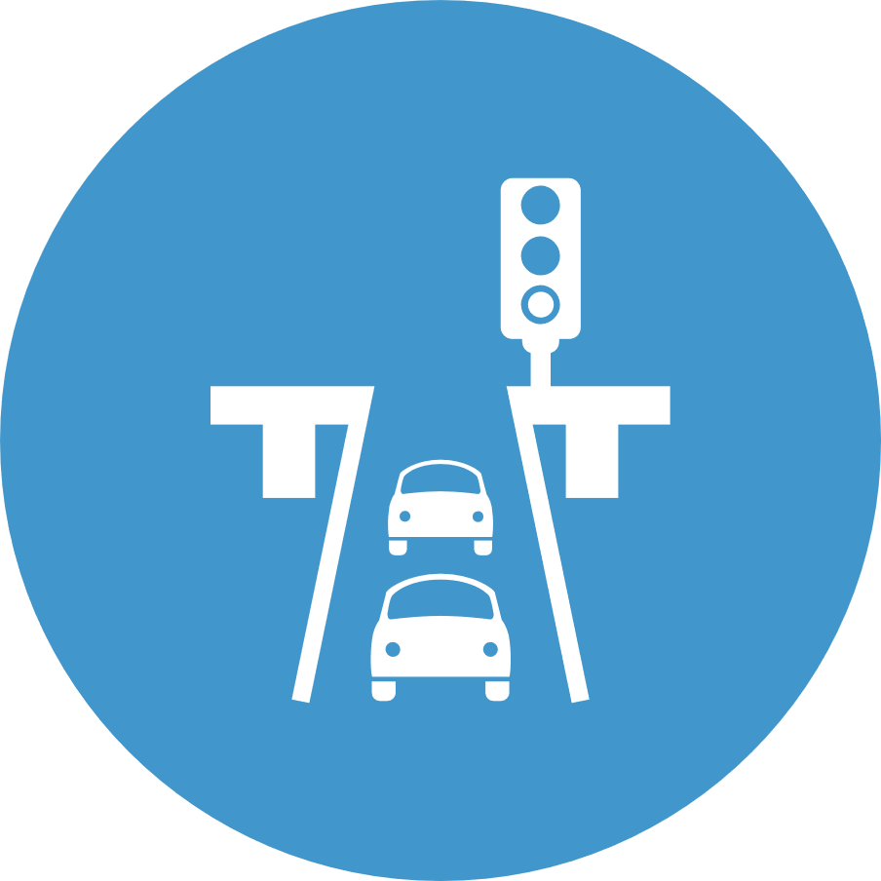
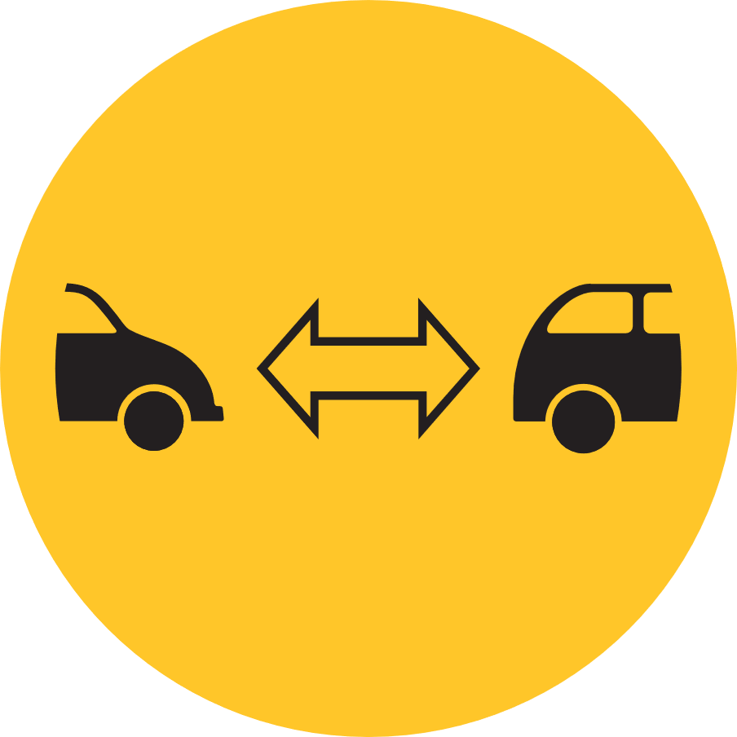
Benefits of Ramp Metering
Controls traffic entering the freeway
Creates larger gaps in traffic to allow for safer merging
Flexible to traffic flow
Notes:
Ramp meters will provide many benefits to the Des Moines metro area, including: 1. Controls traffic entering the freeway
2. Creates larger gaps in traffic to allow for safer merging
3. Flexible to traffic flow

Slide 32
Dynamic Shoulder Use
Notes:
Another ICM tactic planned for Des Moines is Dynamic Shoulder Use, or part-time shoulder use.

Slide 33
What is Dynamic Shoulder Use?
Dynamic part-time shoulder use allows for general purpose traffic to use the shoulder as a travel lane as needed based on real-time traffic conditions.
Signage will be place overhead to alert traffic of upcoming lane changes to allow for seamless merging
Dynamic shoulder use will be operational on I-35/80 between 86th Street and the Northeast Mixmaster [system interchange of I-35/I-80/I-235]
Notes:
Dynamic part-time shoulder use allows for general purpose traffic to use the shoulder as a travel lane as needed based on real-time traffic conditions. Signage will be place overhead to alert traffic of upcoming lane changes to allow for seamless merging. In the event of a crash, heavy congestion or other special event, the signal above the shoulder lane will switch from a red x to a green arrow, indicating that passenger vehicles may use that lane. Dynamic shoulder is planned for I-35/80 between 86th Street and the Northeast Mixmaster.

Slide 34
Why Was Dynamic Shouldering Selected?
Addresses project needs for enhanced mobility, improved reliability, and better management of the system to changing conditions
Less costly than and reduces environmental impact in comparison to traditional freeway widening
Notes:
Dynamic Shouldering address the need for enhanced mobility, improved reliability, and better flexibility. Adding a new temporary lane when traffic backs up, it will increase flow and reduce travel times. It’s also less costly and less impactful to the environment than traditional expanding of freeway lanes.

Slide 35
What is Dynamic Shoulder Use?
Notes:
Dynamic part-time shoulder use allows for general purpose traffic to temporarily use the shoulder as a travel lane as needed based on real-time traffic conditions. When heavy congestion, special events or crashes impact traffic flow, the shoulder can be opened up to passenger vehicles. A green arrow will illuminate when passenger vehicles are allowed to use the part-time lane.

Slide 36
When Will Dynamic Shoulder Use Start?
Planning for dynamic shoulder use are already underway. The project is not currently in the Iowa Statewide Transportation Improvement Program but is targeted for funding around 2025.
Project construction is estimated to take approximately 15 months.
Dynamic shoulder use operation is anticipated to begin in 2025 or 2026.
Notes:
Planning for dynamic shoulder use are already underway. The project is not currently in the Iowa Statewide Transportation Improvement Program but is targeted for funding around 2025. Once granted, construction will take approximately 15 months and scheduled to begin in 2025 or 2026.

Slide 37
Dynamic Shoulder Locations
Proposed ICM projects have overlapping boundaries and are offset for readability.
Notes:
Dynamic Shoulder Use is recommended for I-35 / I-80 between 86th Street and the Northeast MixMaster in Tier 1 within the next 5 to 6 years. The next dynamic shoulder use would be Tier 2 on Interstate 235 between the Southwest MixMaster and 63rd Street within the next 6-10 years.

Slide 38
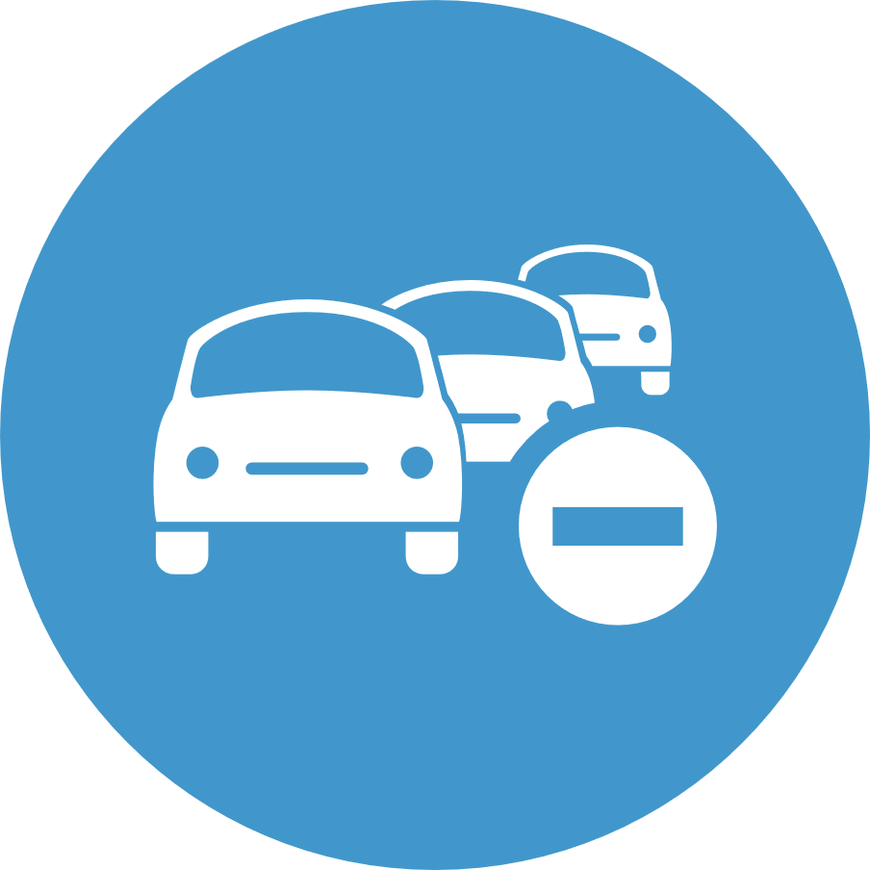
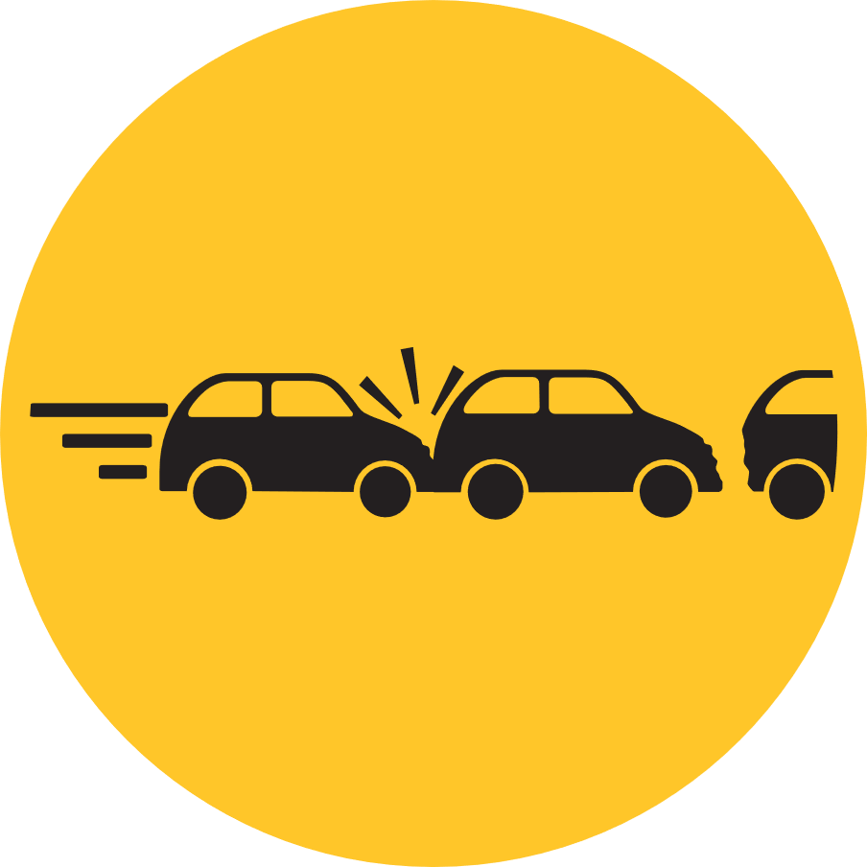
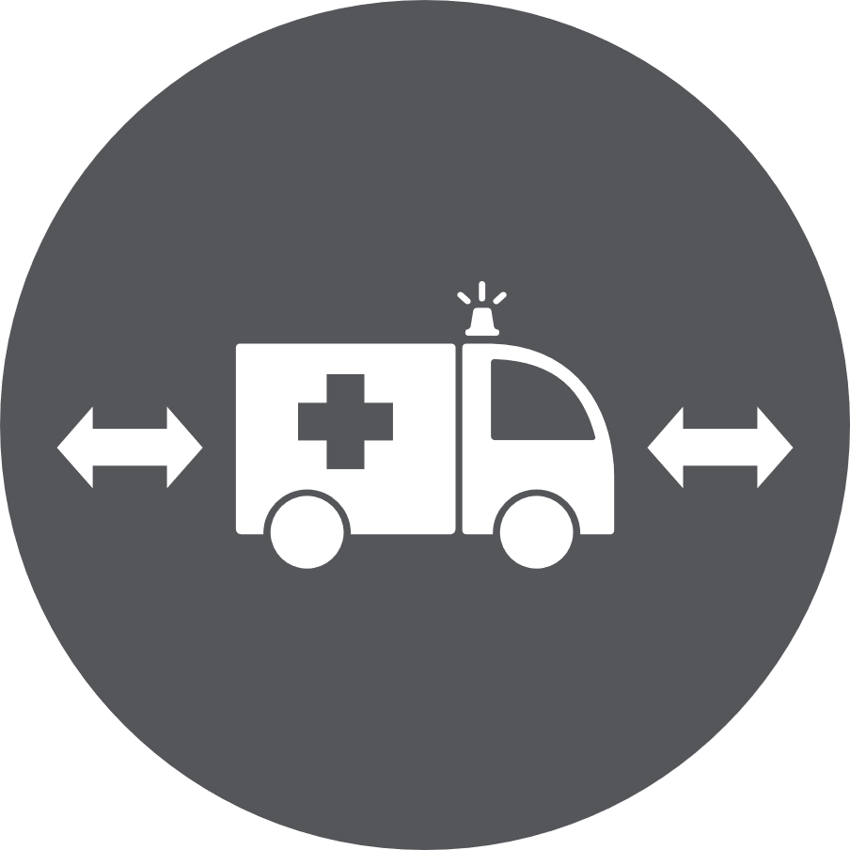
Benefits of Dynamic Shoulder Use
Reduces congestion
Reduces the likelihood of a secondary incident
Emergency crews can use lane to access an incident
Notes:
Dynamic Shoulders reduce the congestion on the freeway. It will also help prevent secondary crashes from occurring as a result of backups and distractions caused by an incident on the freeway. Maintaining the shoulder as a lane will also make it easier for emergency crews to respond to incidents.

Slide 39
Public Transit

Slide 40
Why is Public Transportation a Focus?
Improving public transportation systems and raising public awareness of them is a key element in ICM.
Enhancing our public transportation systems reduces costs, congestion, and the impact our travel has on the environment.
Notes:
ICM is more than just freeway improvements. Improving public transportation systems and raising public awareness of the options available to them is a key element in ICM. Enhancing our public transportation systems reduces costs, congestion, and the impact our travel has on the environment.

Slide 41
Types of Possible Improvements
Enhancements to fare pricing
Signal priority
Transit Incentives
Transit Lanes
Bus Rapid Transit
Transfer Connection Protection
Transit Signal Priority
Express Bus Service
Notes:
There are a variety of ICM tools that could be considered to help improve public transit options. Partners such as DART, HIRTA, DOT are considering what improvements are appropriate for capital investments.

Slide 42
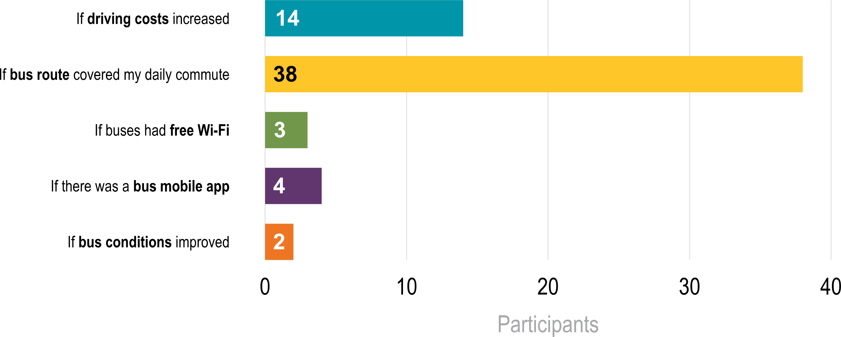
What Will Make You Use Public Transportation?
Notes:
The Des Moines ICM project team produced an online meeting at the end of 2020. One of the questions in the Commuter Survey asked participants what would to take public transportation. The good news is that many of these items mentioned in the survey results are already in-use and available to the public, including a mobile app to purchase bus tickets and free WiFi on all routes.

Slide 43
Current Public Transit Systems

Slide 44
DART
Buses and rideshare vanpool,
Average weekly ridership: 15,664
19 local routes
7 express routes
2 shuttles
5 additional services
Notes:
The Des Moines Area Regional Transit Authority (DART) is the largest public transit agency in Iowa. DART provides resources for those who vanpool, walk, or bike. These services connect thousands of people every day to jobs, school, medical appointments, entertainment and more. DART serves Altoona, Ankeny, Bondurant, Clive, Des Moines, Grimes, Johnston, Pleasant Hill, Polk County, Urbandale, West Des Moines and Windsor Heights.

Slide 45
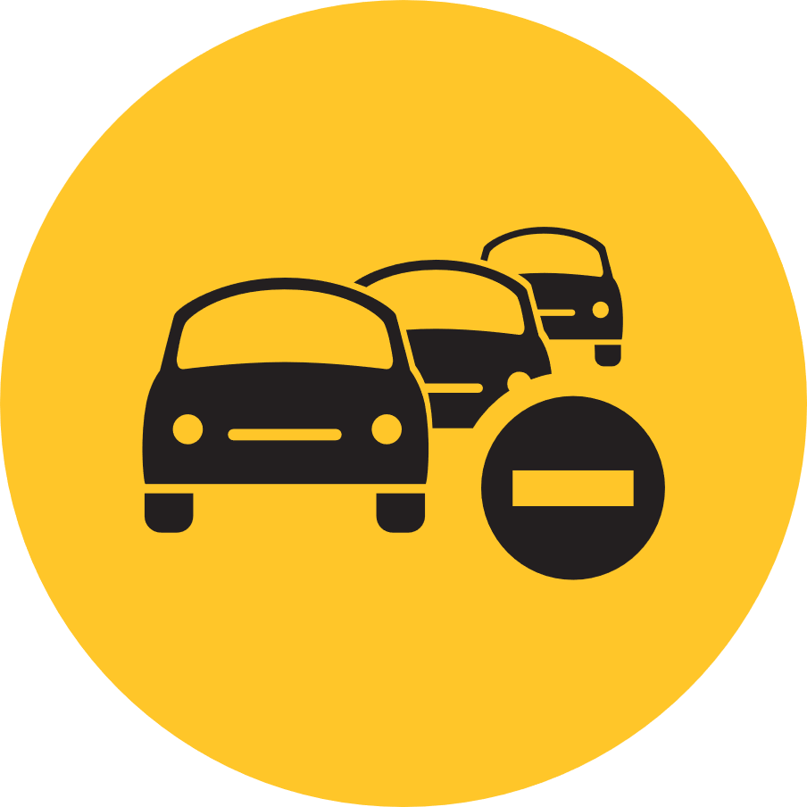
Benefits of DART
Reduced carbon emissions
Reduced traffic congestion
Low-cost for commuters
Notes:
Added Benefits:
More personal time to check emails, watch videos, etc.
Eliminate parking and traffic stressors

Slide 46
Current Programs and Functions
Unlimited Access Program
Employer partnership that grants rider free usage by showing work ID
MYDart App
Convenient way to check routes, track busses, and access important information
Purchase passes directly on your phone
MYDart Trip planner
Receive route guidance based on where you are and where you need to go
Email/Text alerts
Receive updates on delays and route changes in real-time
Notes:
Current tools and programs available through DART include:
• Unlimited Access Program
o Employer partnership that grants rider free usage by showing work ID
• MYDart App
o Convenient way to check routes, track busses, and access important information
o Purchase passes directly on your phone
• MYDart Trip planner
o Receive route guidance based on where you are and where you need to go
• Email/Text alerts
o Receive updates on delays and route changes in real-time

Slide 47
Current Programs and Functions (cont.)
School Tripper
Easy to follow guide for routes servicing area schools.
Ride Match
Service to connect like-commuters for carpooling
Veterans Ride Free
Veterans ride free with valid ID
Notes:
• School Tripper
o Easy guide for students and parents to plan bus routes to schools
• Ride Match
o Service to connect commuters with similar routes for carpooling
• Veterans Ride Free
o Veterans ride free with valid ID

Slide 48
Current Programs and Functions (cont.)
Free Wi-Fi on all routes
Flex Connect
An on-demand service that connects riders in the Flex Connect zone to DART buses. Free Uber ride to connect between stops through September 26, 2021.
Notes:
Additional features:
• Free Wi-Fi on all routes
o Ability to focus on work and entertainment while commuting
• Flex Connect
o An on-demand service that connects riders in the Flex Connect zone to DART buses. Free Uber ride to connect between stops through September 26, 2021.

Slide 49
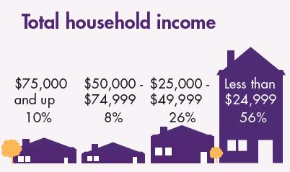
DART Riders
Top 5 Reasons for Riding
Notes:
More than 15,000 people use DART on a workday. 43% of DART users are commuting to work but DART is a great option for entertainment and nightlife.

Slide 50
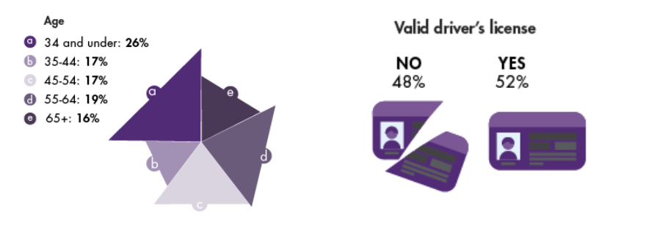
DART Riders
Notes:
DART has annual ridership of 4.4 million. There is no single profile for a DART user. All of us in Des Moines can take advantage of this public transportation option.

Slide 51
HIRTA
Public transit services in the counties of Boone, Dallas, Jasper, Madison, Marion, Story and Warren.
100% of the HIRTA vehicle fleet is ADA-accessible.
Riders schedule trips and pricing is based on in-town, in-county or further.
Notes:
Commuters outside of the Des Moines city limits still have options for public transportation. HIRTA services are available in Boone, Dallas, Jasper, Madison, Marion, Story and Warren.

Slide 52
Benefits of HIRTA
Carbon emissions reduction
Traffic congestion reduction
Cost savings
Notes:
Benefits include reduced carbon emissions, reduced traffic congestion and low-cost for commuters. Taking public transportation means you can avoid traffic headaches and focus on other things instead.

Slide 53
Bike and Pedestrian Transportation
Notes:
Biking or walking is another great way to mix up your commute.

Slide 54
Bike and Pedestrian Trails
63 miles of paved trails
18 miles of soft trails
1 million trips annually
Connectivity to over 550 miles in Central Iowa
Notes:
Des Moines cyclists and walkers have access to 63 miles of paved and 18 miles of soft trails. On average, one million trips on the Des Moines trails system are made annually. For longer trips, the system is connected to over 550 miles of trails in Central Iowa.

Slide 55
Des Moines BCycle
20 stations
120+ bikes (electric and standard)
Good for short trips and connecting between transit stops.
Rates ranging from $3 for a 30-minute ride to $80 for an unlimited annual membership.*
Des Moines BCycle gives Des Moines residents and visitors a new choice for making short trips conveniently and quickly.
Notes:
BCycle is ideal for short distances

Slide 56
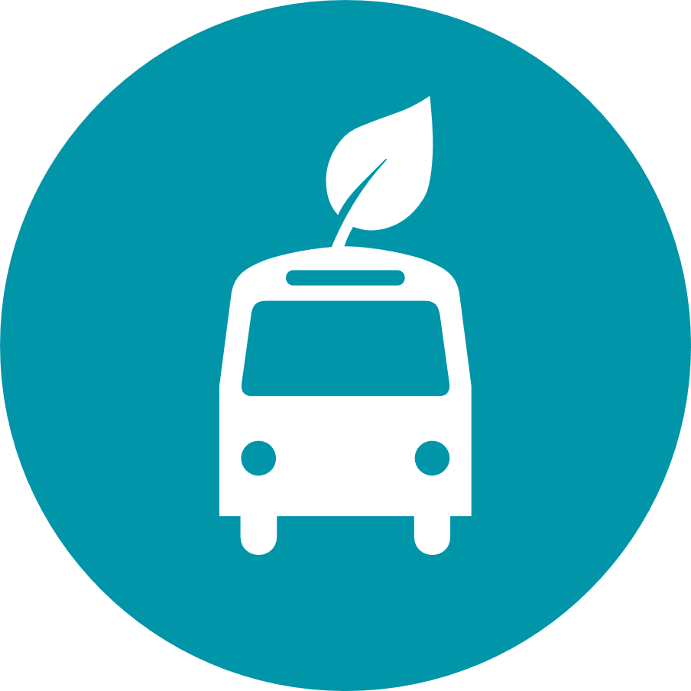
Benefits of BCycle Bike Share
Environmentally-friendly transportation option
Improved health
Low-cost for commuters
Notes:
BCycle Bike share is an environmentally-friendly transportation option with additional health benefits. It is also a cost-effective way for people to bicycle when they need to without the need to invest in their own bike.

Slide 57
Current Programs and Functions
BCycle app - convenient way to pay for rides and unlock bikes.
Memberships - there are several options to reduce the cost of using the bikes. Memberships are also valid in other cities with BCycle - including Omaha and Houston.
Online station map - easy way to quickly find where stations are and plan your route.
Notes:
Current resources for BCycle users include a mobile app to locate and purchase time on a bike. Memberships can be purchased to reduce the cost of service, which can also be used on bike share systems in several other cities.

Slide 58
BCycle Users
Bike share program is in 47 cities, including Des Moines
According the BCycle’s corporate website, Des Moines users increased 29% in 2020 from 2019
Most rides are used for trips of 2 miles or less
Notes:
Adjusted work schedules outside of the traditional “9-5”.
Employees start earlier and leave earlier
Employees start later and leave later
If area employees are reporting to work on the same schedule, the demand on infrastructure can exceed limits.
Earlier and later times are significantly underused.
Do you know your options?

Slide 59
Travel Demand Management

Slide 60
What is Travel Demand Management?
Transportation demand management focuses on changing the behaviors of commuters instead of just expanding the system they use.
This is more than just road construction - it’s also about providing area commuters with information on their options to shift demand toward more underutilized modes.
ICM is about collaboration and coordination - that includes between commuters.
Notes:
Transportation demand management focuses on changing the behaviors of commuters instead of just expanding the system they use.
This is more than just road construction - it’s also about providing area commuters with information on their options to shift demand toward more underutilized modes.
ICM is about collaboration and coordination - that includes between commuters.

Slide 61
Travel Demand Management Elements
Telecommuting Policies
Flexible Work Hours
Notes:
For this section, we’ll be talking about commuter behavior changes that can positively impact commutes in Des Moines. The two elements of travel demand management for the Des Moines ICM project are telecommuting and flexible work hours.

Slide 62
Telecommuting
Telecommuting is when an employee performs nearly all aspects of their job function from home, utilizing the internet, virtual meeting tools, email, and more.
Working from home eliminates the need to commute using a car, public transportation, or other method.
Notes:
Telecommuting is when an employee performs nearly all aspects of their job function from home, utilizing the internet, virtual meeting tools, email, and more. Working from home eliminates the need to commute using a car, public transportation, or other method.

Slide 63
Telecommuting
The COVID-19 pandemic accelerated the potential of working from home for many employees across the Des Moines Metro area.
With fewer workers commuting, it alleviated the demand on the current transportation infrastructure system
Even just telecommuting a few days a week can lighten freeway congestion
Do you know your options?
Notes:
The COVID-19 pandemic accelerated the potential of working from home for many employees across the Des Moines Metro area. With fewer workers commuting, it alleviated the demand on the current transportation infrastructure system. Even just telecommuting a few days a week can lighten freeway congestion. Do you know your options?

Slide 64
Flexible Work Hours
Adjusted work schedules outside of the traditional “9-5”.
Employees start earlier and leave earlier
Employees start later and leave later
If area employees are reporting to work on the same schedule, the demand on infrastructure can exceed limits.
Earlier and later times are significantly underused.
Do you know your options?
Notes:
Another travel demand management strategy is flexible work hours. When a large percentage of the population is traveling to work at the same time, it creates congestion during that time while having the system underutilized immediately after.

Slide 65
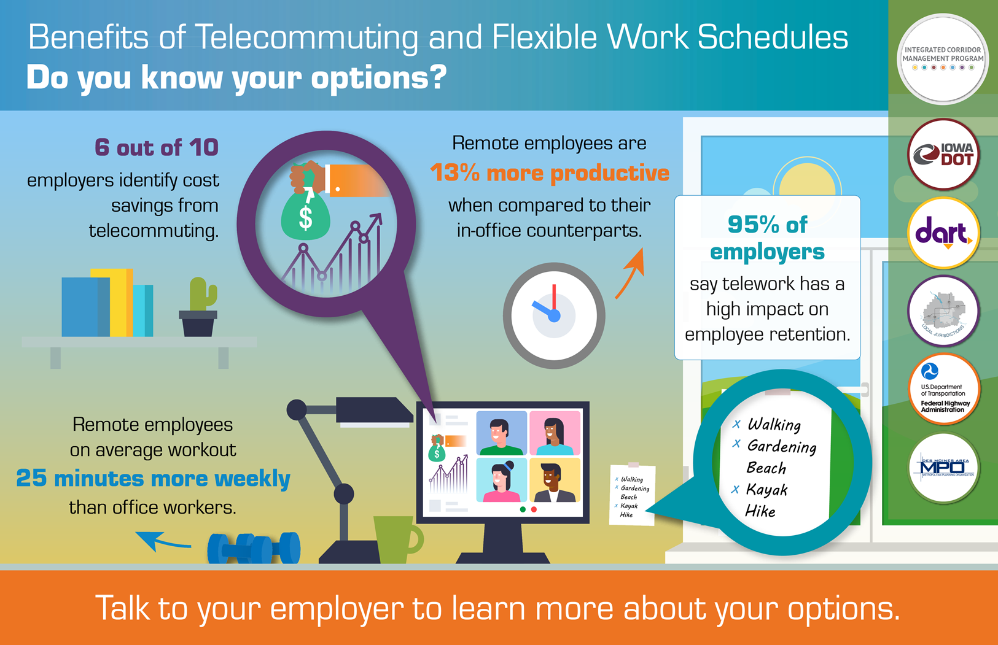

Slide 66
More information
Website: https://iowadot.gov/desmoinesicm Twitter: @iowadot Facebook: /IowaDOT
Email: Iowa DOT Project Manager Neal Fobian neal.fobian@iowadot.us
Notes:
Stay up-to-date and connected with the Des Moines ICM project. Website: https://iowadot.gov/desmoinesicm Twitter: @iowadot Facebook: /IowaDOT Email: Iowa DOT Project Manager Neal Fobian neal.fobian@iowadot.us

